Slide 1
chemical equilibrium systems
CHEMISTRY UNIT 3

Slide 2
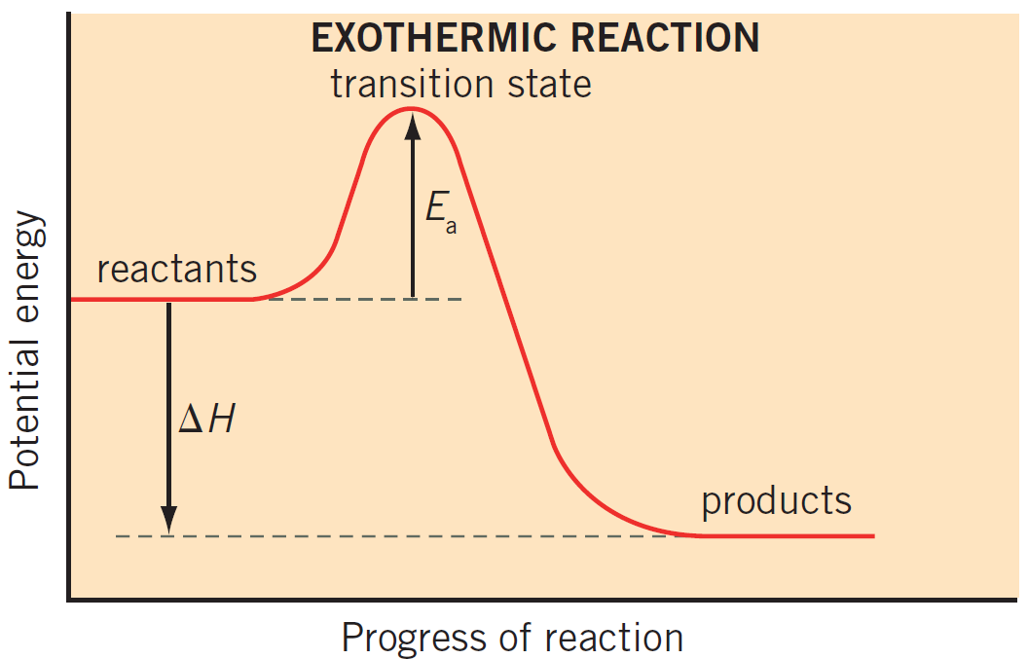
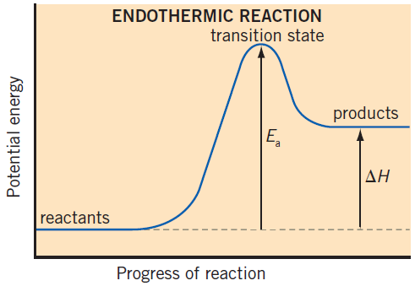
Reaction rates
Collision theory: In order for particles to react, they need to collide with correct orientation and sufficient energy to overcome the activation energy.
Energy profile diagrams:

Slide 3
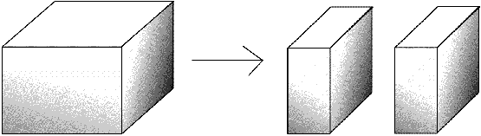
Factors affecting reaction rates
Concentration Affects number of collisions
Surface area Affects number of collisions

Slide 4
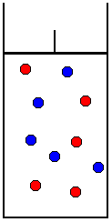
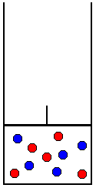
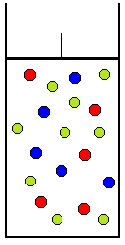
Factors affecting reaction rates
Pressure of gas Depends on how change in pressure was achieved
Control / Comparison
(Red gas reacts with blue gas)
Method for changing pressure | Decrease volume | Add inert gas (green)
Effect on total pressure | Increase | Increase
Effect on partial pressure of reactants | Increase | No change
Effect on collisions between reactants | Increase | No change
Effect on reaction rate | Increase | No effect
This is an important distinction and will be relevant later when discussing equilibrium.

Slide 5
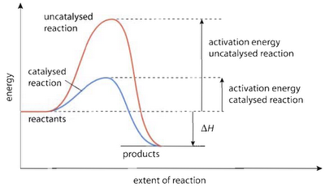
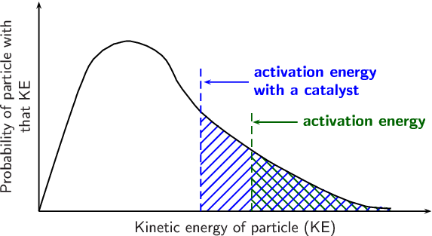
Factors affecting reaction rates
Catalysts Provide an alternate reaction pathway which lowers the activation energy for the reaction. This means a greater proportion of particles have sufficient energy to overcome the activation energy, thus greater percentage of collisions are successful and reaction rate increases.

Slide 6
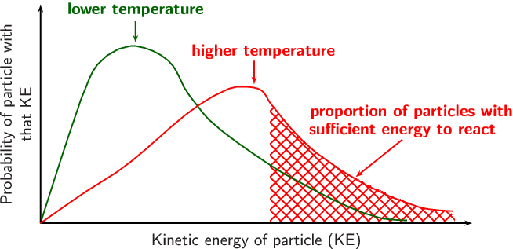
Factors affecting reaction rates
Temperature (1) Increases average kinetic energy of particles. More particles have sufficient energy to overcome E_{a}. (2) Particles move faster, therefore more collisions

Slide 7
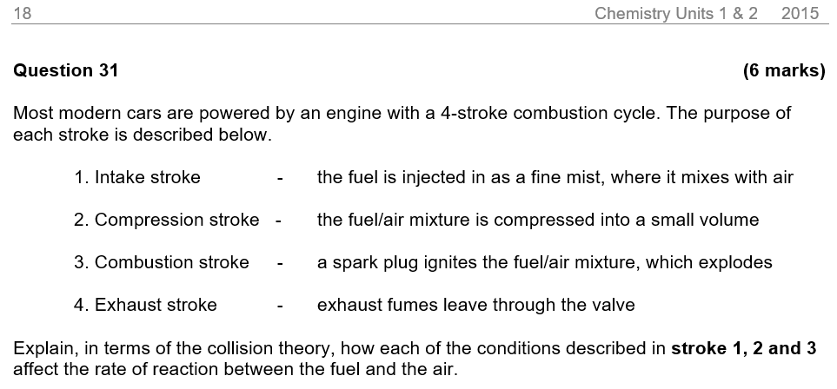
Factors affecting reaction rates

Slide 8
Factors affecting reaction rates

Slide 9
Factors affecting reaction rates
Exam techniques:
In written answers:
Identify the factors affecting reaction rate
Incorporate collision theory as part of your answer. Explicitly use the word “collisions”.
Consider sketching graphs as part of your answer, particularly in extended-answer type questions
In energy profile diagrams:
Common in questions where effect of catalyst needs to be shown
Recognise if the reaction is exothermic (-ΔH) or endothermic (+ΔH) and draw correct graph
Label the axes correctly. The Y-axis is Enthalpy and the units are kJ mol⁻¹. Common to see errors here.
Label ΔH and Ea

Slide 10

Reversible reactions

Slide 11
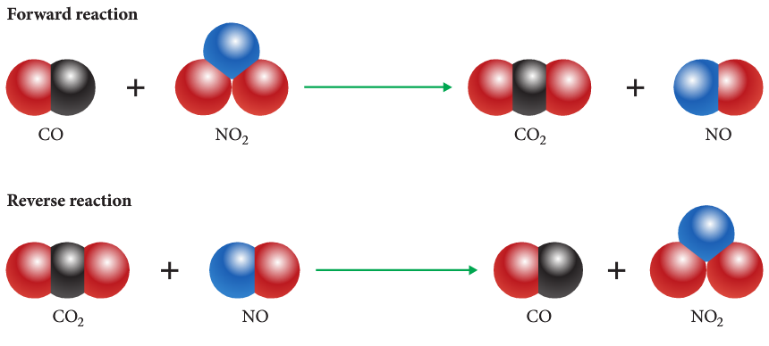
Reversible reactions
A reversible reaction is a reaction where:
Reactants form products
Products form reactants
CO + NO₂ ⇌ CO₂ + NO

Slide 12
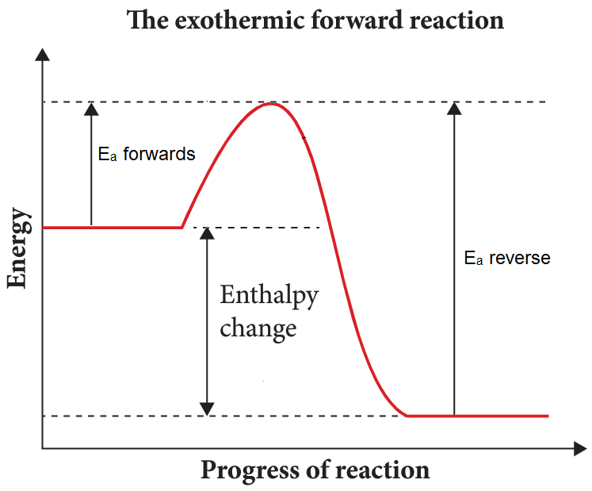
Reversible reactions
Reversible reactions and energy profile diagrams:
Key features:
Forwards reaction is exothermic
Reverse reaction is endothermic
Values of ΔH_{forwards} and ΔH_{reverse} will be opposite
Each reaction has a different activation energy

Slide 13
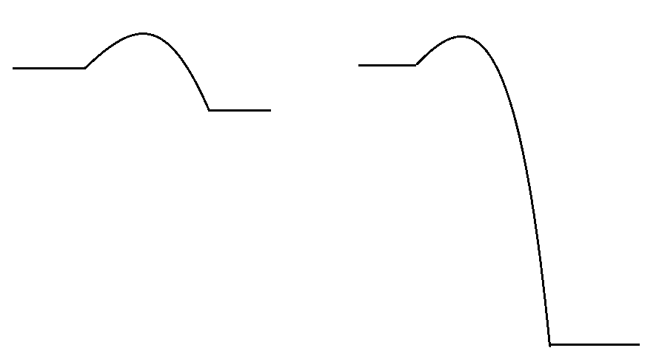
Reversible vs irreversible
E_{a} for.
E_{a} for.
reactants
E_{a} rev.
reactants
products
If the E_{a} of the reverse reaction is extremely large then the reverse reaction is very unlikely to occur.
∴ irreversible reaction
E_{a} rev.
Enthalpy
products
Reaction progress
Reaction progress

Slide 15
CHARACTERISTICS OF DYNAMIC equilibrium
When a system is in dynamic equilibrium:
The rates of forwards and reverse reactions are equal
The concentrations of reactants and products are constant*
The macroscopic properties are constant
Colour of mixture
Mass of solid
Pressure of gas
* Constant means unchanging. It doesn’t mean equal (to each other). Be very careful with language here.

Slide 16
Graphing DYNAMIC equilibrium

Slide 17
Graphing DYNAMIC equilibrium

Slide 18
Drawing equilibrium graphs
Questions in booklet.

Slide 19
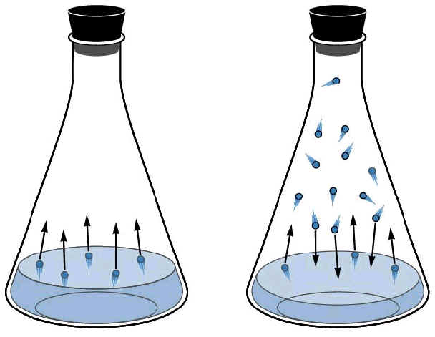
Physical Equilibrium
Physical change: A change where no new substances are formed
Chemical change: A change that produces new substances
Vapour Pressure Explain how the diagram shows equilibrium.
Write an equation for this reaction.

Slide 20
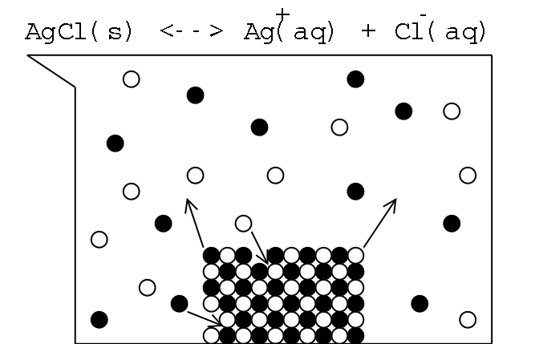
Physical Equilibrium
Saturated solutions The diagram to the right shows a saturated solution of silver chloride. Would it be right to say that a solutes stops dissolving in saturated solutions? Explain.

Slide 21
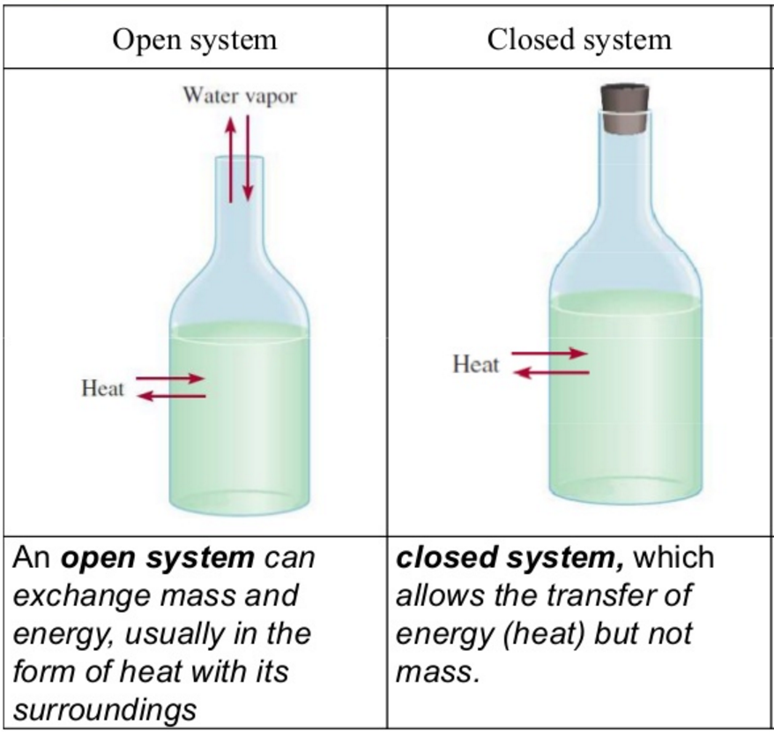
Do all systems form equilibrium?
For a system to form dynamic equilibrium there need to be two conditions:
1) The reaction is reversible
2) The system is closed
Open system: A chemical system in which substances are able to enter or leave
Closed system: A chemical system in which no substances are able to enter or leave

Slide 22
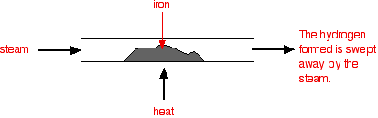
Do all systems form equilibrium?
Example: 3 Fe(s) + 4 H₂O(g) ⇌ Fe₃O₄(s) + 4 H₂(g)
By passing steam over the iron you can form Fe₃O₄. The hydrogen is swept away by the steam. Although the reaction is theoretically reversible, the H₂ is removed before it can react with the Fe₃O₄. This is an open system and it will not reach equilibrium.

Slide 23
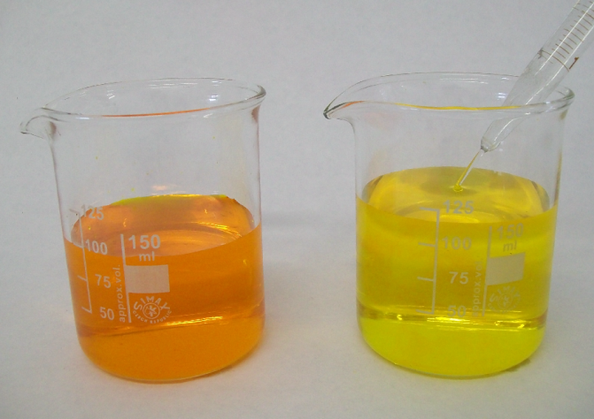
Changes to concentration
In this experiment we will investigation how concentration affects the equilibrium between potassium chromate (K₂CrO₄) and potassium dichromate (K₂Cr₂O₇).
These two species exist in equilibrium with each other:
2 CrO₄²⁻ + 2 H⁺ ⇌ Cr₂O₇²⁻ + H₂O
yellow orange

Slide 24
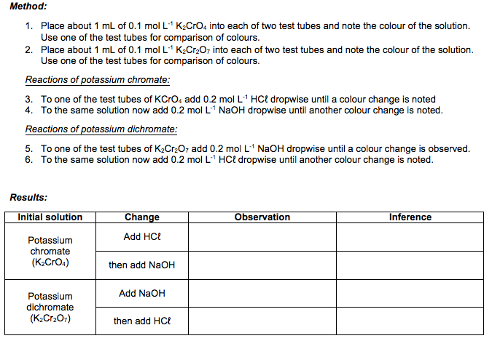

Slide 25
Changes to concentration
What evidence is there that the system is in dynamic equilibrium prior to adding HCℓ or NaOH? What evidence is there that adding HCℓ or NaOH temporarily disrupts equilibrium?
The colour of the solution was constant (unchanging)
Changes in colour were observed, indicating that the concentrations of CrO₄²⁻ and Cr₂O₇²⁻ were changing

Slide 26
Le Châtelier’s principle
Le Châtelier’s principle is a useful tool for predicting the effects of changes to systems at equilibrium.
It states:
“If a system at equilibrium is subject to a change in conditions, then the system will behave in such a way as to partially counteract the change.”
Le Châtelier’s principle predicts how a system will react, but does not explain why the system reacts in such a way. To explain in written answers you will need to use collision theory.

Slide 27
Applying L.C.P. to concentration
2 CrO₄²⁻ + 2 H⁺ ⇌ Cr₂O₇²⁻ + H₂O
Imposed change: Adding HCℓ increased the [H⁺] [H⁺] = concentration of H⁺
Effect: The system shifted to the ____________ to ____________ the [H⁺]
This caused the [__________] to increase, ∴ solution became more _____________
right
decrease
Cr₂O₇²⁻
orange

Slide 28
Applying L.C.P. to concentration
2 CrO₄²⁻ + 2 H⁺ ⇌ Cr₂O₇²⁻ + H₂O
Imposed change: Adding NaOH decreased the [H⁺]
Effect: The system shifted to the ____________ to ____________ the [H⁺]
This caused the [__________] to increase, ∴ solution became more _____________
left
increase
CrO₄²⁻
yellow

Slide 29
Applying L.C.P. to concentration
Important notes about changes in concentration:
Changes in concentration relate to aqueous and gaseous species
Adding a liquid does not change its concentration and will not affect equilibrium*
Adding an insoluble solid does not change its concentration and will not affect equilibrium
* If you add H₂O to a system with dissolved ions, you won’t change the concentration of the water itself, but you will change the concentration of substances dissolved in the water. We will look at this advanced example later.

Slide 30
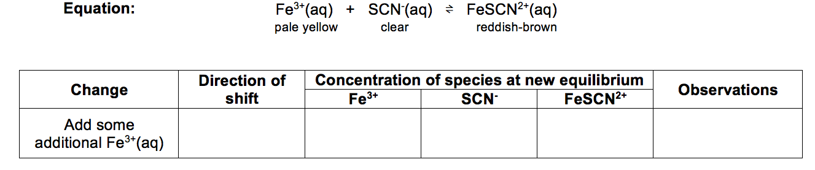
right
increase
decrease
increase
more red

Slide 31
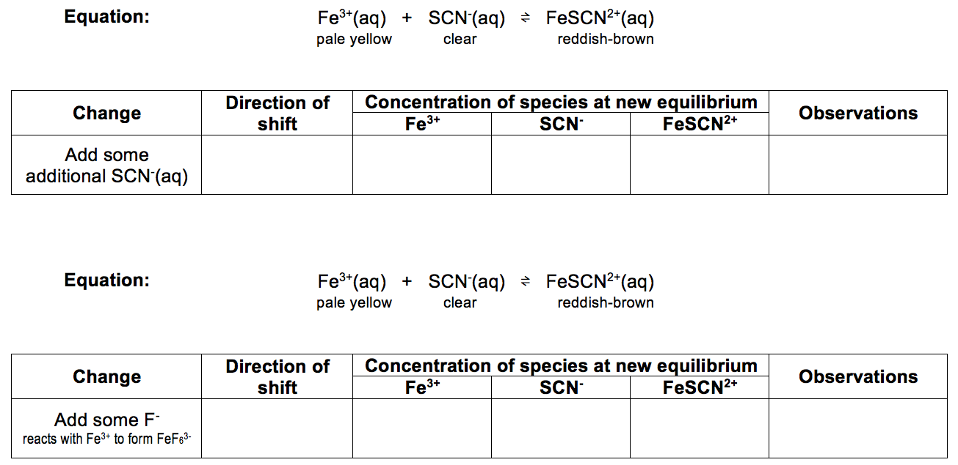
right
decrease
increase
increase
more red
left
decrease
increase
decrease
less red

Slide 32
CHANGES TO CONCENTRATION
We know from Le Châtelier’s principle that adding H⁺ to the chromate/dichromate system causes the reaction to shift right, producing more Cr₂O₇²⁻. This is confirmed by the colour change.
But why does it shift to the right? (“Le Châtelier’s principle said so” is not an explanation.)
To explain the shift we need to apply collision theory.
2 CrO₄²⁻ + 2 H⁺ ⇌ Cr₂O₇²⁻ + H₂O
yellow orange

Slide 33
CHANGES TO CONCENTRATION
Use collision theory to explain the change that occurs when HCℓ is added to chromate/dichromate.
2 CrO₄²⁻ + 2 H⁺ ⇌ Cr₂O₇²⁻ + H₂O
yellow orange
Adding HCℓ increases the [H⁺]. This increases the rate of forwards reaction due to more collisions between H⁺ and CrO₄²⁻.
The system is no longer at equilibrium because forwards rate > reverse rate.
Over time, this leads to [reactants] decreasing and [products] increasing, causing forwards rate to decrease and reverse rate to increase until equilibrium is re-established
The colour change from yellow to orange is due to increasing [Cr₂O₇²⁻] as equilibrium is re-established

Slide 34
DILUTING SOLUTIONS
If water is added to a system with multiple (aq) substances, it will decrease the concentration of all aqueous species.
Le Châtelier’s principle predicts the reaction will favour whichever side produces more moles of (aq) as this will increase the overall concentration of ions.
If both sides of the equation have equal moles of (aq), then the reaction will not shift. These reactions remain at equilibrium when diluted.

Slide 35
DILUTING SOLUTIONS
Example: PbI₂(s) ⇌ Pb²⁺(aq) + 2 I⁻(aq)
Prediction of shift: Diluting a saturated solution of lead(II) iodide causes the reaction to shift right, as the R.H.S. has more moles of aqueous substances (3 mol vs 0 mol).
Observation: More of the yellow solid dissolves
0 moles (aq) 3 moles (aq)

Slide 36
Changes to PARTIAL PRESSURE
‘Partial pressure’ refers to the pressure of an individual gas within a mixture. It is changed by adding or removing the gas from the mixture.
A change to the partial pressure of a gas is effectively the same as a change in concentration. It can be explained in terms of collision theory using very similar terminology.
Q: At what time did the reaction (first) reach equilibrium? Justify your answer.
Q: What could have caused the change at occurred after 25 minutes?
Q: Explain the change in shape from t=25 to t=45.

Slide 37
Changes to PRESSURE – SIZE OF CONTAINER
Changing the size of a container will change the partial pressures of all gaseous substances.
If you reduce the size of the container you will increase overall pressure.
Le Châtelier’s principle predicts the system will oppose this change by favouring the side of the reaction with the least moles of gas.
If you increase the size of the container you will decrease overall pressure.
Le Châtelier’s principle predicts the system will oppose this change by favouring the side of the reaction with the most moles of gas.

Slide 38
Le Châtelier’s principle: VOLUME OF GASES
Example #1: 3 H₂(g) + N₂(g) ⇌ 2 NH₃(g)
Change: Decrease the volume of the container, causing overall pressure to increase
Effect: According to Le Châtelier’s principle, the system will shift in a way to reduce overall pressure. Reaction would shift right as the R.H.S. has less moles of gas (2 mol vs. 4 mol).
4 moles of gas
2 moles of gas

Slide 39
Le Châtelier’s principle: VOLUME OF GASES
Example #1: 3 H₂(g) + N₂(g) ⇌ 2 NH₃(g)
Change: Decrease the volume of the container, causing overall pressure to increase
Effect: According to Le Châtelier’s principle, the system will shift in a way to reduce overall pressure. Reaction would shift right as the R.H.S. has less moles of gas (2 mol vs. 4 mol).
4 moles of gas
2 moles of gas

Slide 40
Le Châtelier’s principle: VOLUME OF GASES
Example #2: N₂(g) + O₂(g) ⇌ 2 NO(g)
Change: Increase the volume of the container, causing overall pressure to decrease
Effect: Both sides have equal moles of gas so they would not be affected by a change in overall pressure.
2 moles of gas
2 moles of gas

Slide 41
Changes to PRESSURE – SIZE OF CONTAINER
Use collision theory to explain the changes the occur when a syringe containing the following gases is compressed:
2 NOCℓ(g) ⇌ 2 NO(g) + Cℓ₂(g)
When the volume of the syringe is compressed in increases the partial pressure (concentration) of all gaseous species.
This increases the rate of both reactions due to more collisions between gaseous particles, but the reverse rate increases more than the forwards rate because the reverse reaction requires the collision of more particles.
Over time the [reactants] increases and [products] decreases, causing the forwards rate to increase and reverse rate to decrease until equilibrium is re-established

Slide 42
Changes to temperatures
Changing the temperature will cause the reaction to favour either the endothermic or exothermic reaction.
Imposed change: Increase the temperature of a system
Method of counteracting: Favour the endothermic reaction (removes heat)
Imposed change: Decrease the temperature of a system
Method of counteracting: Favour the exothermic reaction (produces heat)

Slide 43
Le Châtelier’s principle: TEMPERATURE
Reaction | Imposed change | Direction of shift
N₂(g) + 3 H₂(g) ⇌ 2 NH₃(g); ΔH = -92 kJ | Increase the temperature
H₂(g) + I₂(g) ⇌ 2 HI(g); ΔH = +52 kJ | Decrease the temperature
Ag⁺(aq) + Cℓ⁻(aq) ⇌ AgCℓ(s) + 112 kJ | Decrease the temperature

Slide 44
Le Châtelier’s principle: TEMPERATURE
Experiment:
2 NO₂(g) ⇌ N₂O₄(g) ΔH = -57 kJ
brown colourless
Predict how temperature will affect the colour of a mixture of NO₂ and N₂O₄. Justify your reasoning using Le Châtelier’s principle.

Slide 45
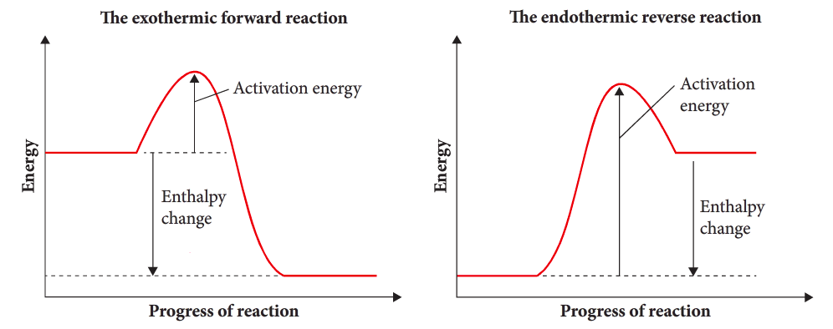
EXPLAINING EFFECT OF TEMPERATURE
Temperature increases the rate of reaction due to particles having greater kinetic energy, therefore having more energy than the activation energy.
BUT… in a reversible reaction the two reactions have different activation energies.
The endothermic reaction has the largest E_{a}, so it is always affect more by increases or decreases in temperature.

Slide 46
EXPLAINING EFFECT OF TEMPERATURE
Explain, using collision theory, why the yield (amount) of N₂O₄ decreases when a tube containing NO₂ and N₂O₄ is heated.
2 NO₂(g) ⇌ N₂O₄(g) ΔH = -57 kJ
Heating the tube increases both the forwards and reverse reaction rates. This is due to particles having greater E_{K}, and a greater proportion of particles having E_{K} > E_{a}. This results in an increased number of collisions, and a greater proportion of those collisions lead to successful reactions.
Endothermic reactions are more affected by changes in temperature because they have a greater activation energy barrier, therefore the reverse rate increases more than the forwards rate.
Reverse rate is favoured, therefore over time [NO₂] increases and [N₂O₄] decreases. This causes reverse rate to increase and forward rate to decrease until equilibrium is re-established (both rates equal)

Slide 47
EXPLAINING EFFECT OF TEMPERATURE
Increase in temperature:
This change provides more kinetic energy to particles (∴ both rates increase)
The endothermic reaction has the greatest activation energy, so an increase in temperature will have the biggest effect on the endothermic reaction. ∴ endothermic reaction is favoured*
(*This may be forwards or reverse reaction… will depend on question)

Slide 48

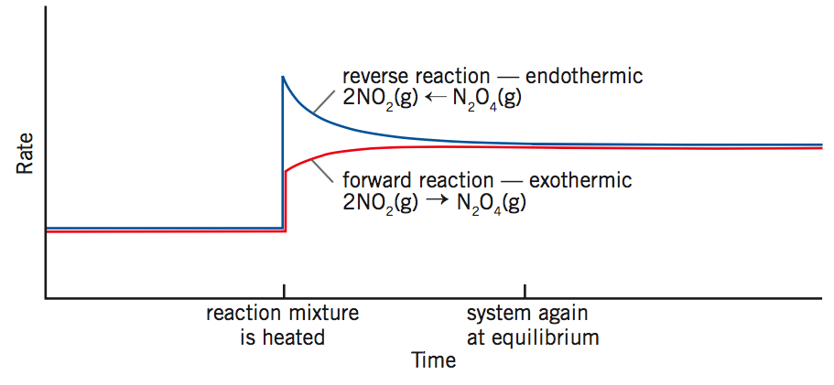
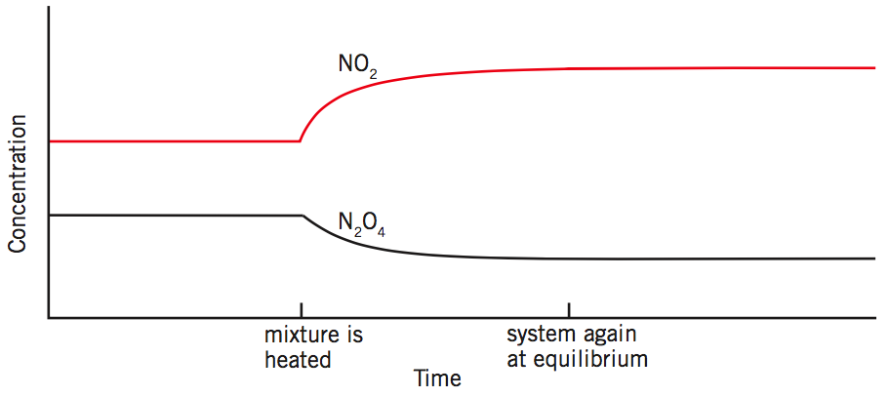

Slide 49
Changes to temperature
H₂(g) + I₂(g) ⇌ 2 HI(g) ΔH = +52 kJ/mol
Predict which reaction will be favoured. Justify your answer and sketch the graphs below

Slide 50
Changes to temperature
Production of ethanol from ethene:
CH₂=CH₂(g) + H₂O(g) ⇌ CH₃CH₂OH(g) ΔH = -45 kJ/mol
The activation energy for the forwards reaction is 22 kJ/mol.
Draw a labelled energy profile diagram for this reaction, showing ΔH, Ea and Ea reverse. Use this energy profile diagram to explain the temperature conditions that would be used in an industrial process to achieve the maximum yield (amount) of ethanol.

Slide 51
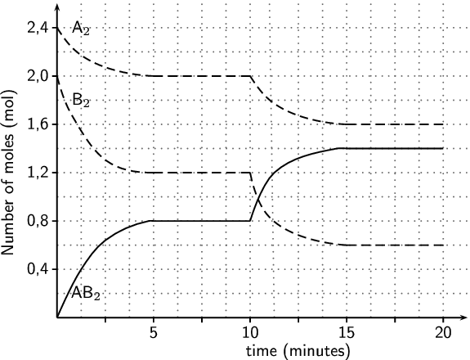
Changes to temperature
The reaction pictured left was heated after 10 minutes. The equation is:
A₂ + 2 B₂ ⇌ 2 AB₂
Is the forwards reaction endothermic or exothermic? Justify your reasoning.

Slide 52
Factors that do not affect equilibrium
In the past pages we have considered how temperature, concentration and pressure affect equilibrium. It is worthwhile also realising that some changes don’t have any impact on systems at equilibrium. These include:
Amount of an (insoluble) solid
Solids do not change their concentration.
AgCℓ(s) ⇌ Ag⁺(aq) + Cℓ⁻(aq)
Adding additional AgCℓ(s) to a saturated solution of AgCℓ will not change the concentration of Ag⁺(aq) or Cℓ⁻(aq). Addition of a solid does not affect equilibrium.

Slide 53
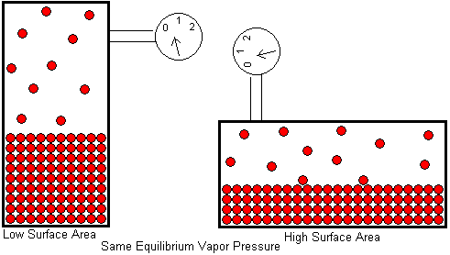
Factors that do not affect equilibrium
Amount of liquid
Adding a liquid does not change its concentration
Vapour pressure equilibrium: Br₂(ℓ) ⇌ Br₂(g)
Increasing surface area will increase rate of evaporation and condensation equally.
*Exception: Addition of water to a mixture containing (aq) substances will affect the concentration of the (aq) substances, therefore will affect equilibrium.

Slide 54
Factors that do not affect equilibrium
Inert gases
Equilibrium is affected when the forwards and reaction rates are not equal.
Adding an inert (unreactive) gas increases total pressure, but does not affect collisions between reacting particles and has no effect on forwards and reverse reaction rates. Therefore it will have no effect on equilibrium either.

Slide 55
Factors that do not affect equilibrium
Adding a catalyst
Adding a catalyst increases both rates equally.
Both rates are still equal, ∴ the reaction is still at equilibrium.

Slide 56
Equilibrium constants
Systems at equilibrium will have a certain ratio of reactants to products at a given temperature. This ratio is called the equilibrium constant (K).
Same temp.
Different starting concentrations
Different final concentrations
Same ratio

Slide 57
Equilibrium constants
Equilibrium constants are written as a ratio of [products] / [reactants].
Solids and liquids are not included in the equilibrium constant because their concentrations do not change during the reaction.
For the reaction:
Example: H₂(g) + I₂(g) ⇌ 2 HI(g)
coefficients
Chemical symbols

Slide 58
Equilibrium constants
Information given by K:
K tells you the relative amounts of products and reactants at equilibrium
If K is very large, reaction heavily favours the products
If K is very small, reaction heavily favours the reactants
K does not tell you anything about the rate of the reaction
Effect of temperature:
Temperature is the only thing that affects the value of K
If increasing the temperature favours more products, then increasing temp. will increase K
If increasing the temperature favours more reactants, then increasing temp. will decrease K

Slide 59
Equilibrium constants
See past questions in workbook

Slide 60
Industrial processes
Industrial processes need to make as much product as quickly and cheaply as possible. This means that industrial chemists need to consider factors affecting rate, yield and cost.
Ways of altering these factors include:
Changing temperatures
Changing gas pressures
Adding catalysts
Removing products as they are formed (i.e. having an open system)

Slide 61
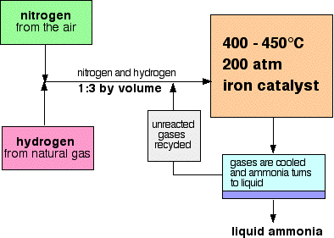
Haber process
Reaction: N₂(g) + 3 H₂(g) ⇌ 2 NH₃(g) ΔH = -92 kJ mol⁻¹
Use: Ammonia is used in manufacture of fertilisers, explosives, household cleaners. It is also an important chemical for the manufacture of nitric acid.
Conditions used:

Slide 62
Haber process
Justification for conditions:
(1) Temperature
High temperatures would increase the rate of production due to particles having greater kinetic energy, and more particles having energy greater than the activation energy.
Low temperatures would increase the equilibrium yield of ammonia. According to Le Châtelier’s principle, decreasing the temperature would favour the endothermic (forwards) reaction.
The temperature conditions that are used at moderate, and are a compromise between rate and yield.

Slide 63
Haber process
Justification for conditions:
(2) Pressure
High pressures would increase the rate of production due to more collisions between gas particles.
High pressures would also increase the equilibrium yield of ammonia. According to Le Châtelier’s principle, high pressures favour the side of the reaction with the least moles of gas which is the right hand side (4 moles → 2 moles).
The chosen pressure of 200 atmospheres is high to maximise rate and yield. Higher pressures are possible, but higher pressures are too expensive to maintain and could explode.

Slide 64
Haber process
Justification for conditions:
(3) Catalyst
An iron-based catalyst is used. Catalysts increase the rate of reaction by providing an alternate reaction pathway with a lower activation energy. This means that more particles at a given temperature can react because they have energy greater than the catalysed activation energy.
Catalysts do not affect equilibrium yield because the increase forward and reverse rates equally. This means that catalysts can increase rate without negatively affecting yield, giving them an economic benefit.

Slide 65
Haber process
Justification for conditions:
(4) Removing the ammonia
In the final stage of the process the ammonia is liquified and removed. The unreacted N₂ and H₂ are re-added to the reaction mixture to keep reacting.
Removing the ammonia prevents the reverse reaction from happening, stopping the NH₃ from reacting again to make N₂ and H₂.
When the unreacted gases are added back into the reaction mixture they increase the concentration of reactants and cause the reaction to shift to the right, allowing more NH₃ to be produced.

Slide 66
CONTACT PROCESS
Refer to workbook. ☺

